Slide 1







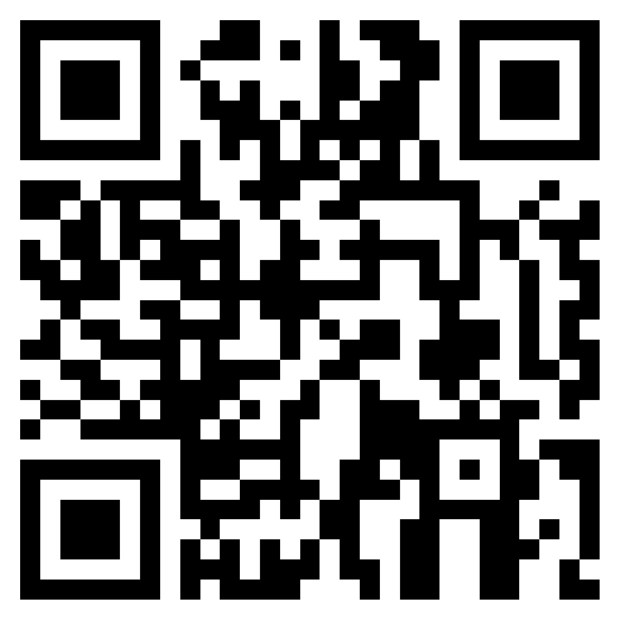


The Overcoming Programme
Bury’s Educational Psychology Service are offering group sessions for parents to help them support their child if they are experiencing anxiety.
What is the overcoming programme?
The Overcoming Programme involves 6 sessions aimed at parents/carers of children aged between 5 and 12 years old where the main concern is anxiety. The programme uses a Cognitive Behavioural Therapy (CBT) based approach to focus on changing the way adults around the child respond to anxious feelings by problem solving and creating shared goals and rewards.
8-10 other parents will be in the group with you. There will be five 2 hour sessions over the six weeks. These sessions may be delivered in person or online dependant upon parent feedback. This will be followed by an individual appointment four weeks after the programme ends. The session dates and times will be planned in accordance with parent feedback. Sessions will be delivered during Spring term.
Session overview
Week 1 – TBC
Week 2 –TBC
Week 3 - TBC
Week 4 – TBC
Week 5 - BREAK
Week 6 – TBC
Week 10 - Individual telephone follow-up
Evidence behind the programme
The Overcoming Programme has strong evidence behind it and is based on the book Helping Your Child with Fears and Worries (Creswell & Willetts, 2019). You will be able to read (or listen to) this book to help you as you work though the programme
What to expect:
How to book on?
  An opportunity to meet other parents/ carers who are experiencing a similar situation and support from the group, as well as the Educational Psychology Service.
  Time to think about how you can best support your child at home and the strategies you can use to do this.
  ‘Homework’ between sessions (reading/ listening to part of the book, trying out new strategies with your child).
  Attendance at all sessions is really important. Both parents are welcome to attend, but it is important that one parent attends consistently
To register your interest please complete the expression of interest form:
Expression of interest- Overcoming parent workshops – Fill in form
The CEPS team will then be in touch to complete referrals once expressions of interest are completed.
Contact Information
If you have any further questions, please contact your link CEPS team

